Slide 1
What is Life?
Biology is the study of life - but what does it mean to be alive?
  Ludwig von Bertalanffy – life is a system where the whole is greater than the sum of the parts
Living organisms and many non-living things share three properties
  Complexity
  Movement
  Response to stimulation

Slide 2
Properties of Life
All living organisms share five basic properties
  Cellular Organization
    All living organisms are composed of at least one cell
  Metabolism
    All living organisms use energy
  Homeostasis
    All living organisms maintain stable internal conditions
  Growth and reproduction
    All living organisms grow and reproduce
  Heredity
    All living organisms possess a genetic system that is based on DNA (Deoxyribonucleic acid)

Slide 3
Life is an Emergent Property
Each higher level of organization contains novel properties not present at the simpler level of organization
  Birth rate & death rate – populations NOT individuals
  Evolution – populations evolve biologically NOT individuals
These properties are termed emergent properties
  They are a consequence of the structural organization that is the hallmark of life
  They characterize many aspects of the living world

Slide 4
Five Themes That Unify Biology
Evolution
  The gene frequencies change in a species over time
    Causes include:
      Genetic drift
      Natural & artificial selection
      Founder effects
The Flow of Energy
  All living organisms require energy
  The sun is the source of energy for most ecosystems
  Plants capture energy via photosynthesis
    They then act as an energy source for other organisms
Interaction
  Interaction between organisms is critical for evolution
    Social behavior occurs when organisms of the same species live in direct contact
    Community dynamics occur when organisms of different species live in direct contact (Competition, Predation, Symbiosis)
Structure Determines Function
  Biological structures are well suited to their function
    This is true at every level of organization
Homeostasis
  All living organisms act to maintain a relatively stable internal environment
  Maintaining homeostasis requires energy and a lot of signaling back-and-forth between cells

Slide 5
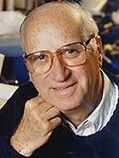
Koshland, D.E. (2002) The seven pillars of life. Science 295: 2215-2216.

Slide 6
“The first pillar of life is a Program.
By program I mean an organized plan that describes both the ingredients themselves and the kinetics of the interactions among ingredients as the living system persists through time. For the living systems we observe on Earth, this program is implemented by the DNA that encodes the genes of Earth's organisms and that is replicated from generation to generation, with small changes but always with the overall plan intact. The genes in turn encode for chemicals--the proteins, nucleic acids, etc.--that carry out the reactions in living systems.
It is in the DNA that the program is summarized and maintained for life on Earth.”

Slide 7
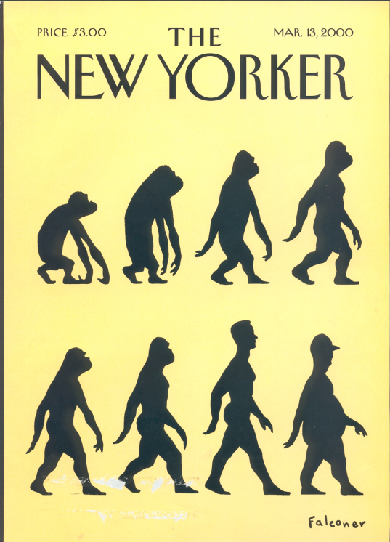
“The second pillar of life is IMPROVISATION.
Because a living system will inevitably be a small fraction of the larger universe in which it lives, it will not be able to control all the changes and vicissitudes of its environment, so it must have some way to change its program. If, for example, a warm period changes to an ice age so that the program is less effective, the system will need to change its program to survive.
In our current living systems, such changes can be achieved by a process of mutation plus selection that allows programs to be optimized for new environmental challenges that are to be faced.”

Slide 8
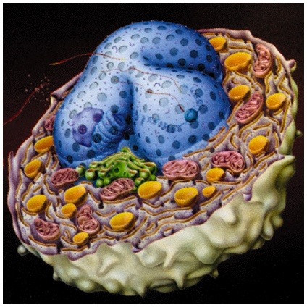
“The third of the pillars of life is COMPARTMENTALIZATION.
All the organisms that we consider living are confined to a limited volume, surrounded by a surface that we call a membrane or skin that keeps the ingredients in a defined volume and keeps deleterious chemicals--toxic or diluting--on the outside. Moreover, as organisms become large, they are divided into smaller compartments, which we call cells (or organs, that is, groups of cells), in order to centralize and specialize certain functions within the larger organism.”

Slide 9
“The fourth pillar of life is ENERGY.
Life as we know it involves movement--of chemicals, of the body, of components of the body--and a system with net movement cannot be in equilibrium. It must be an open and, in this case, metabolizing system. Many chemical reactions are going on inside the cell, and molecules are coming in from the outer environment--O2, CO2, metals, etc. The organism's system is parsimonious; many of the chemicals are recycled multiple times in an organism's lifetime (CO2, for example, is consumed in photosynthesis and then produced by oxidation in the system), but originally they enter the living system from the outside, so thermodynamicists call this an open system. Because of the many reactions and the fact that there is some gain of entropy (the mechanical analogy would be friction), there must be a compensation to keep the system going and that compensation requires a continuous source of energy. The major source of energy in Earth's biosphere is the Sun--although life on Earth gets a little energy from other sources such as the internal heat of the Earth--so the system can continue indefinitely by cleverly recycling chemicals as long as it has the added energy of the Sun to compensate for its entropy changes.”

Slide 10
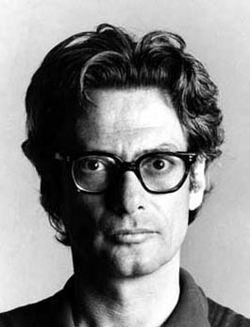

“The fifth pillar is REGENERATION.
Another system for regeneration is the constant resynthesis of the constituents of the living system that are subject to wear and tear. For example, the heart muscle of a normal human beats 60 times a minute--3600 times an hour, 1,314,000 times a year, 91,980,000 times a lifetime. No man-made material has been found that would not fatigue and collapse under such use, which is why artificial hearts have such a short utilization span. The living system, however, continually resynthesizes and replaces its heart muscle proteins as they suffer degradation; the body does the same for other constituents--its lung sacs, kidney proteins, brain synapses, etc.”

Slide 11
“The sixth pillar is ADAPTABILITY.
Improvisation is a form of adaptability, but is too slow for many of the environmental hazards that a living organism must face. For example, a human that puts a hand into a fire has a painful experience that might be selected against in evolution--but the individual needs to withdraw his hand from the fire immediately to live appropriately thereafter.
That behavioral response to pain (a reflex) is essential to survival and is a fundamental response of living systems that we call feedback.”

Slide 12
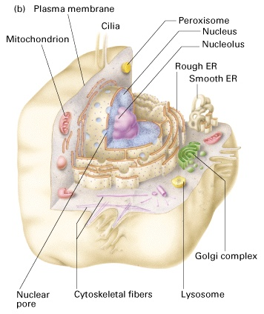
“Finally, and far from the least, is the seventh pillar, SECLUSION.
By seclusion, in this context, I mean something rather like privacy in the social world of our universe.”

